Slide 1

CARZZ
A hand gesture controlled car
BY:
TECHNOARMOR

Slide 2
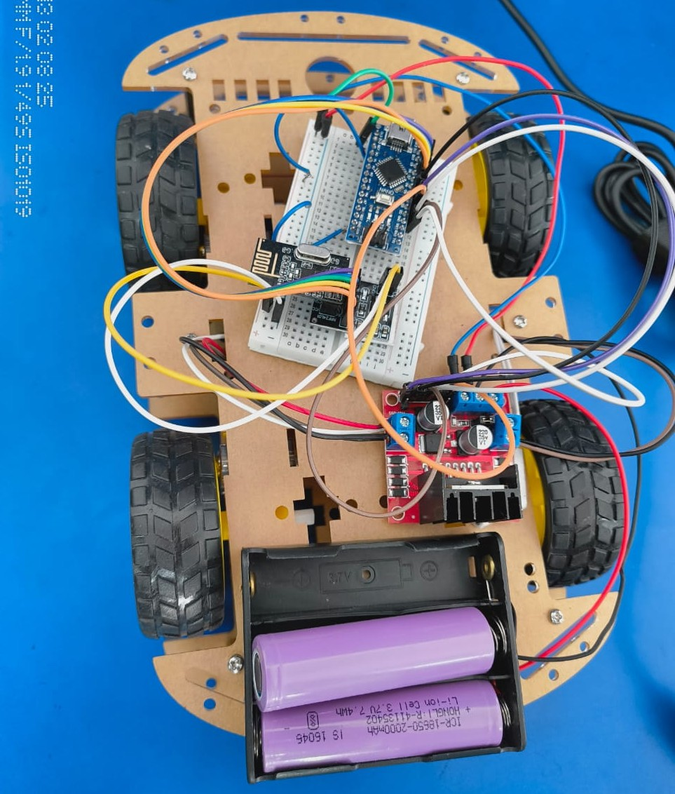
CARZZ : Hand gesture controlled car

Slide 3
Team TechnoArmor
Joy Ghatak
Debanjan Karmakar
Soumya Mondal
Debanjan Mondal
Mehul Ghosh

Slide 4

Introduction
Imagine a world where you can control vehicles with just a wave of your hand. Welcome to the future of technology—gesture-controlled cars. This innovative project combines the power of Arduino microcontrollers, motor drivers, and gesture sensors to create a seamless and intuitive way to drive a car.

Slide 5

Problems we are solving:
Accessibility for Disabled Drivers: Traditional car controls are not user-friendly for individuals with physical disabilities.
Parking in Tight Spaces: Many drivers struggle with parking in congested areas, leading to accidents or inefficiencies.
Hands-Free Operation: Drivers are distracted by manually operating secondary functions like air conditioning or infotainment systems.
Hazardous Driving Environments: Direct human operation in disaster zones or hazardous areas poses significant risks.
Contactless Interaction: Hygiene concerns have increased the demand for touchless controls, especially in shared or public vehicles.

Slide 6
Components
Arduino UNO
MPU 6050
L298N Motor Driver
NRF24LO1
NRF ADAPTOR

Slide 7
FUTURE MODIFICATIONS :
Obstacle avoiding system: We can use an ultrasonic sensor in the front part of the car. That we understand the distance of the obstacle and change the direction of car.
Wind speed senor: detects winds speed and direction , helpful for outdoor navigation. Using the Anemometer.

Slide 8
Thanks

